Slide 1

CASE STUDY : LENDER CLUB
AUTHORS
SAYANTAN BISHAL
SENTHIL KUMAR S

Slide 2
Business Objectives
Identification of faulty applicants through EDA
Identity the variables which are strong indicator of default
Provide details of the analysis and help the company to minimize the loss
.

Slide 3
DATA CLEANING
Fix the rows and columns
Standardized values
Fix the invalid values in dataframe
Fix the missing values
Filtered the data as per the requirement

Slide 4
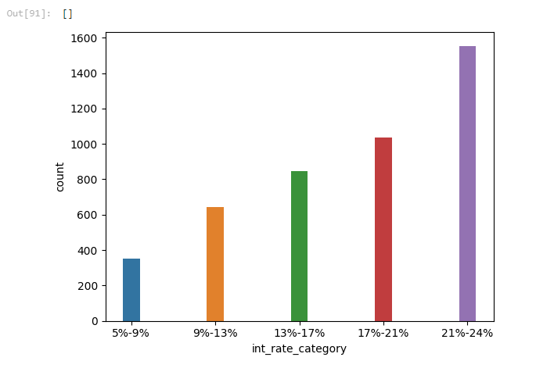
Driving Factor : Interest Rate (int_rate) EDA Type: Univariate Analysis and segmented univariate Graph Type: Bar Plot Analysis: As the graphs inform, 1. Applicants having the higher interest rate in loan are more likely to be defaulter.

Slide 5
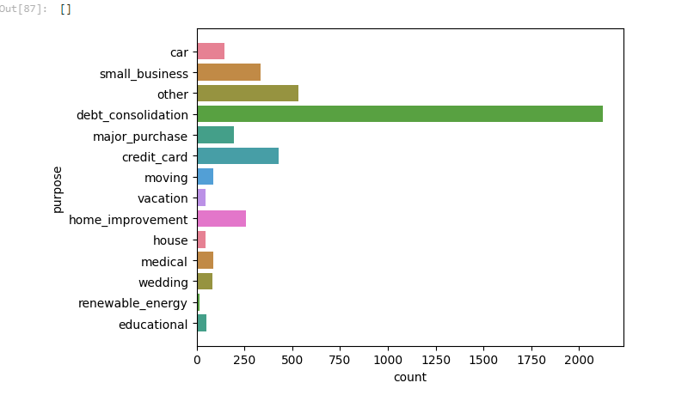
Driving Factor : Purpose EDA Type: Univariate Analysis and segmented univariate Graph Type: Bar chart Analysis: More people took a new loan to clear up the old loans, this kinds of applicants having high possibility they might default the loan.

Slide 6
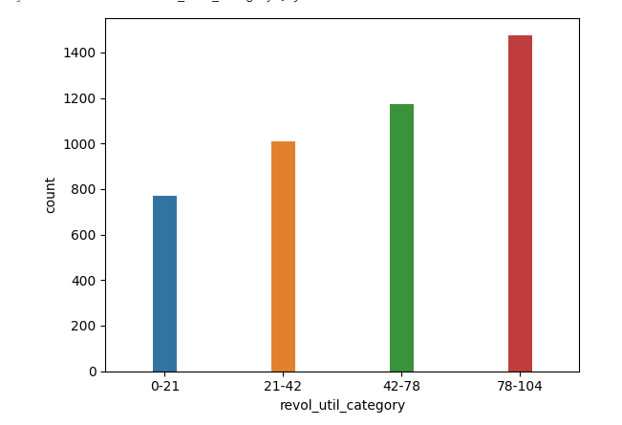
Driving Factor : revol_util EDA Type: Univariate Analysis and segmented univariate Graph Type: Bar chart Analysis: Higher the revolving utilization rate more chances of getting default.

Slide 7
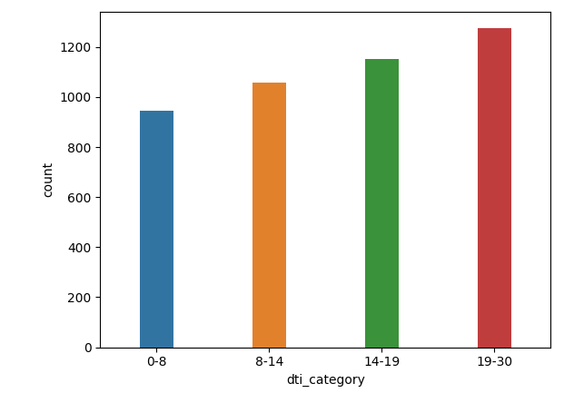
Driving Factor : dti EDA Type: Univariate Analysis and segmented univariate Graph Type: Bar chart Analysis: Higher the debt-to-income higher is the chances of getting default

Slide 8
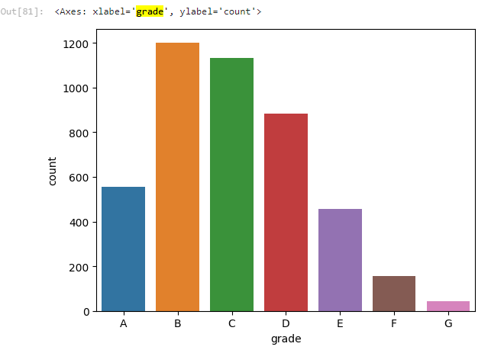
Driving Factor : grade EDA Type: Univariate Analysis and segmented univariate Graph Type: Bar chart Analysis: Applicants loan which are marked as the as B by LC are more likely to be fall under defaulter list.

Slide 9
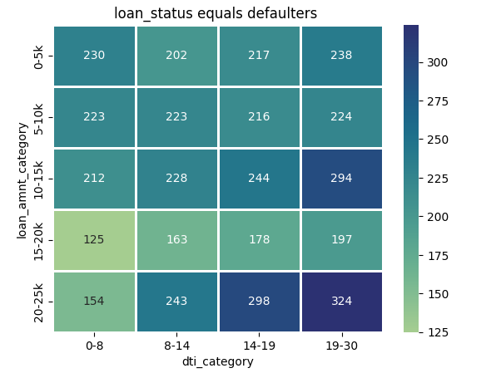
Driving Factor : loan vs dti EDA Type: Bivariate Analysis Graph Type: Heatmap Analysis: Applicants whose high dti range and high loan amounts having higher chances of getting their loan default.

Slide 10
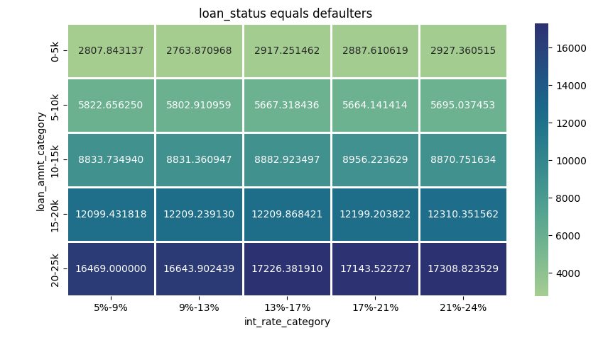
Driving Factor : loan vs interest_rate EDA Type: Bivariate Analysis Graph Type: Heatmap Analysis: Applicants who have take loans at much higher interest rate more like likely to be a defaulter

Slide 11
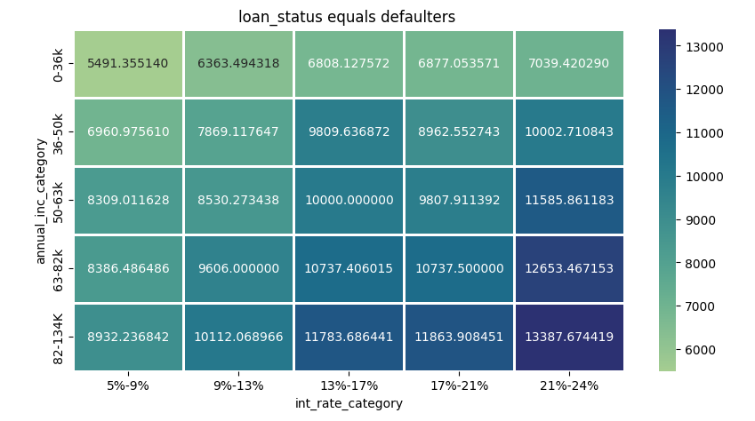
Driving Factor : int_rates vs annual_inc on loan_amnt. EDA Type: Multivariate Analysis Graph Type: heatmap Analysis: 1. Even people with high annual income also falls under defaulter list. 2. The people who has taken loans for any purpose in high interest rate are more likely to fall under defaulter list

Slide 12
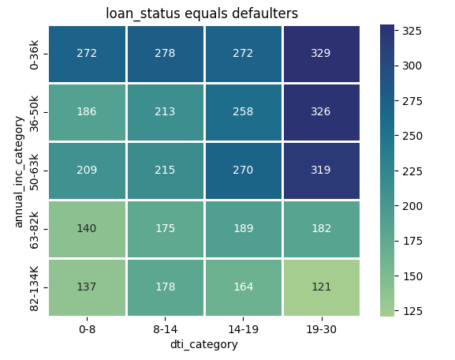
Driving Factor : dti vs annual_inc EDA Type: Bivariate Analysis Graph Type: heatmap Analysis: Applicants having lower income range and having higher dti rate more likely to fall under defaulter list.

Slide 13
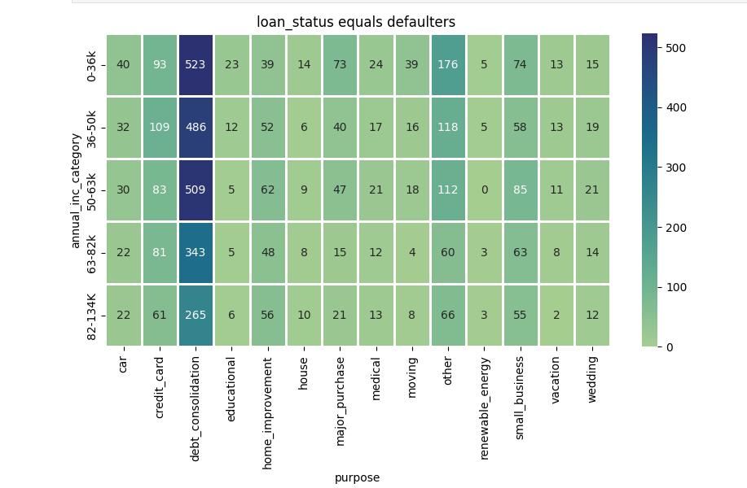
Driving Factor : purpose vs annual_inc EDA Type: Bivariate Analysis Graph Type: heatmap Analysis: Applicants having lower income range and took loans for debt consolidations.

Slide 14
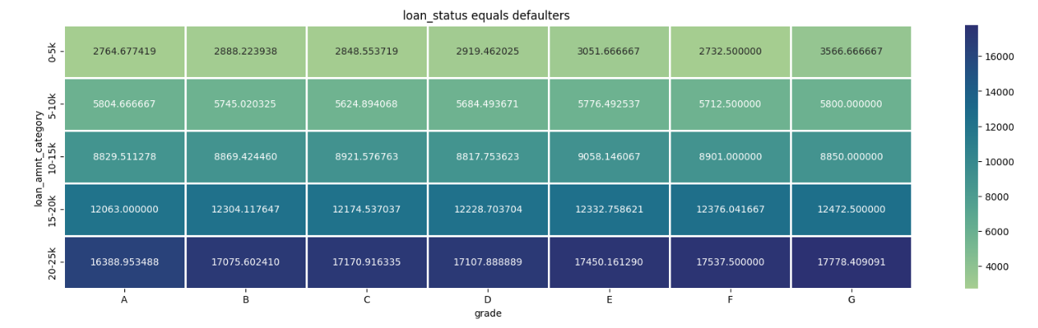
Driving Factor : loan_amnt vs grade EDA Type: Bivariate Analysis Graph Type: heatmap Analysis: Applicants borrow high loan amounts and marked as Grade G by LC more likely to be a defaulter.

Slide 15
Conclusions:
The people who has taken loans for any purpose in high interest rate are more likely to fall under defaulter list.
Higher DTI (debt to income ratio) suggests higher chance of default.
There is an increased chance of default when purpose is debt_consolidation.
Higher loan amount results in higher chance of default.
Applicants having lower income range and having higher dti rate more likely to fall under defaulter list.
Applicants whose high dti range and high loan amounts having higher chances of getting their loan default.
Applicants who have take loans at much higher interest rate more like likely to be a defaulter.
Applicants having lower income range and took loans for debt consolidations.
Higher the revolving utilization rate more chances of getting default.

Slide 16
DRIVING FACTORS: 1. Interest rate 2. Purpose 3. Grade 4. revol_util 5. DTI (Debt to income ratio)

Slide 17
THANKYOU
BATCH MAY 31,2024

